Slide 1
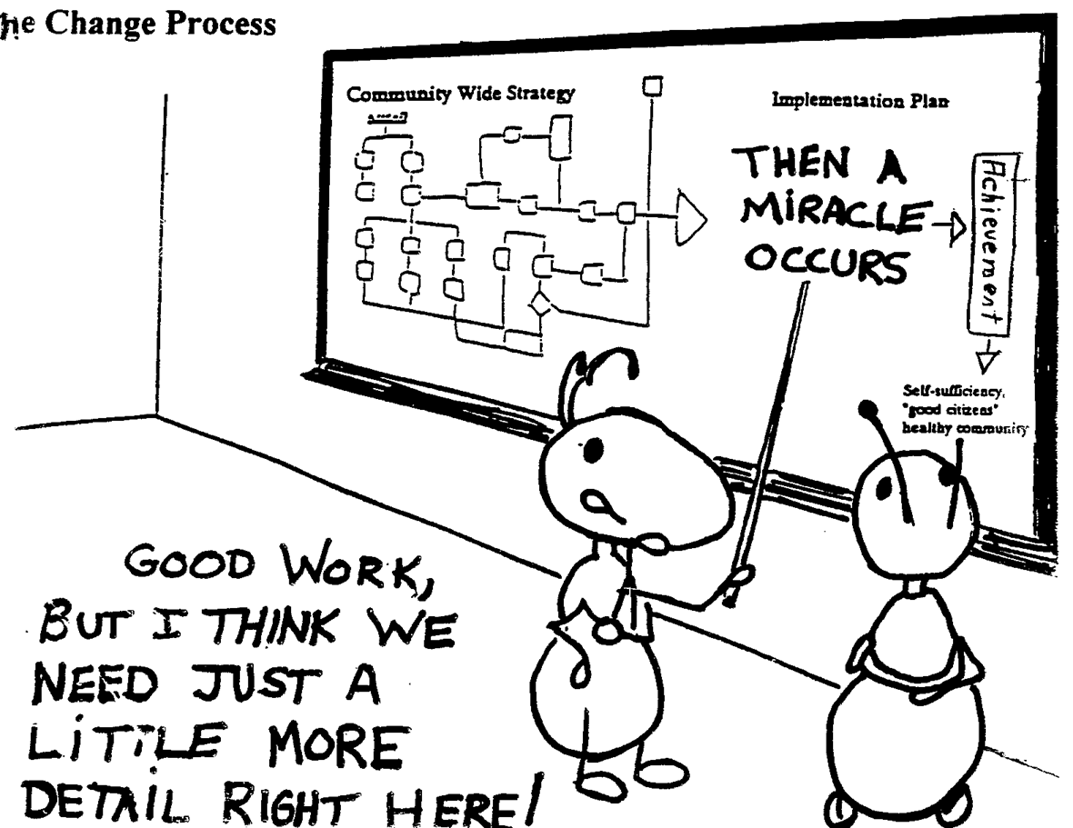
Digital Project Stages: Publication
Notes:
Oftentimes researchers see technology as a magic elixir and it clouds the process of doing a digital project and the time that it takes. Though the stages of a digital project are the same as a traditional research project, it’s good to think about these stages one at a time and consider the 3 aspects in each stage.

Slide 2
Three Stages of Digital Project
Collection
Analysis
Publication

Slide 3
Stage 3: Publication
Stage 1 (Collection) and Stage 2 (Analysis) of the digital project are all about structuring and shaping data, stage 3 is about about presenting that data as effectively as possible
Publication platform selection typically goes hand in hand with previous tool choices (a common misunderstand is a project’s final presentation was its initial conception)

Slide 4
What We Have To Say Matters
Look at the two visualization created from Mason Currey’s Daily Rituals about the habits of creatives throughout history:
https://podio.com/site/creative-routines
http://infowetrust.com/creative-routines/ (for closer view of https://digitalsynopsis.com/inspiration/famous-creative-routines/)
What’s different about the two publications? Does the difference change the message being communicated? How hard do you think these visuals were to make?

Slide 5
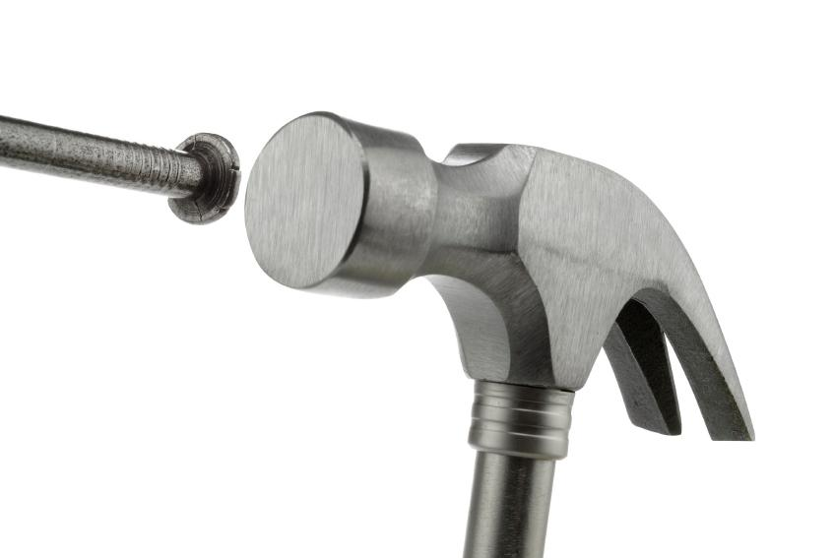
Tool Selection
Notes:
The analysis stage is where tool selection decision will rare it’s ugly head.

Slide 6
To Build Or Not To Build
One misconception about digital projects is they only require one tool
Another common misconception about digital projects is the finish product resembles the original conception
Be wary of the application that does it all
Always consider the many factors (time, resources, project goals, etc. ) before you build
Notes:
It is not uncommon to use a different tool in each stage of a digital project and multiple tools in one stage

Slide 7
Picking A Technology
Main Factor:
Does the tool do what you need it to do?
Other factors:
Cost:
Purchase / license / support / add-ons / services
Infrastructure requirements
Existing staff expertise
Long-term maintainability
Licensing agreements (e.g., mobile apps)

Slide 8
Picking A Technology, Part 2
Even more factors:
Size of user community
The more user a product has, the more people you can ask for help and the more likely it is usually that it will be maintained over a longer period of time
Hosting:
Especially for web-based tools (e.g., Omeka), it is important to find an appropriate host
Re-usability for other projects
Potential for growing expertise

Slide 9
Build Your Own System
Advantages:
You can do anything you want
Disadvantages:
You can do anything you can afford
Can mean significant investment
Often tied to existing staff skills portfolio
Often duplication of effort

Slide 10
Adopt & Adapt
Advantages:
Lower implementation costs
Using proven platform means you’ll encounter fewer bugs
Less tied to specific staff
Can draw on community expertise
Any modifications / additions you create can benefit a larger community
Disadvantages:
May not get everything you want

Slide 11
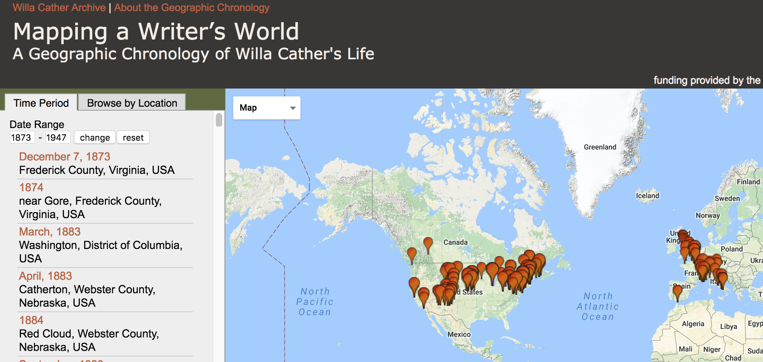
Tool Selection Analysis
“Mapping a Writer's World: A Geographic Chronology of Willa Cather's Life" is an effort to research, articulate, and visualize [Cather’s erpetual travl] to help teachers, readers, and scholars better understand this travel and its effect on Cather's writing.”
“Mapping a Writer's World: A Geographic Chronology of Willa Cather's Life" is an effort to research, articulate, and visualize [Cather’s perpetual travel] to help teachers, readers, and scholars better understand this travel and its effect on Cather's writing.” http://cather.unl.edu/geochron/

Slide 12

Project Under the Hood
Mapping a Writer’s World
Staff
4 design and database
1 technology support/developer
Technology requirements
Experience with Leaflet Javascript
Basic knowledge of Open Street Maps API
Project Scope = Purpose + Audience + Resources (staff + expertise + time)

Slide 13
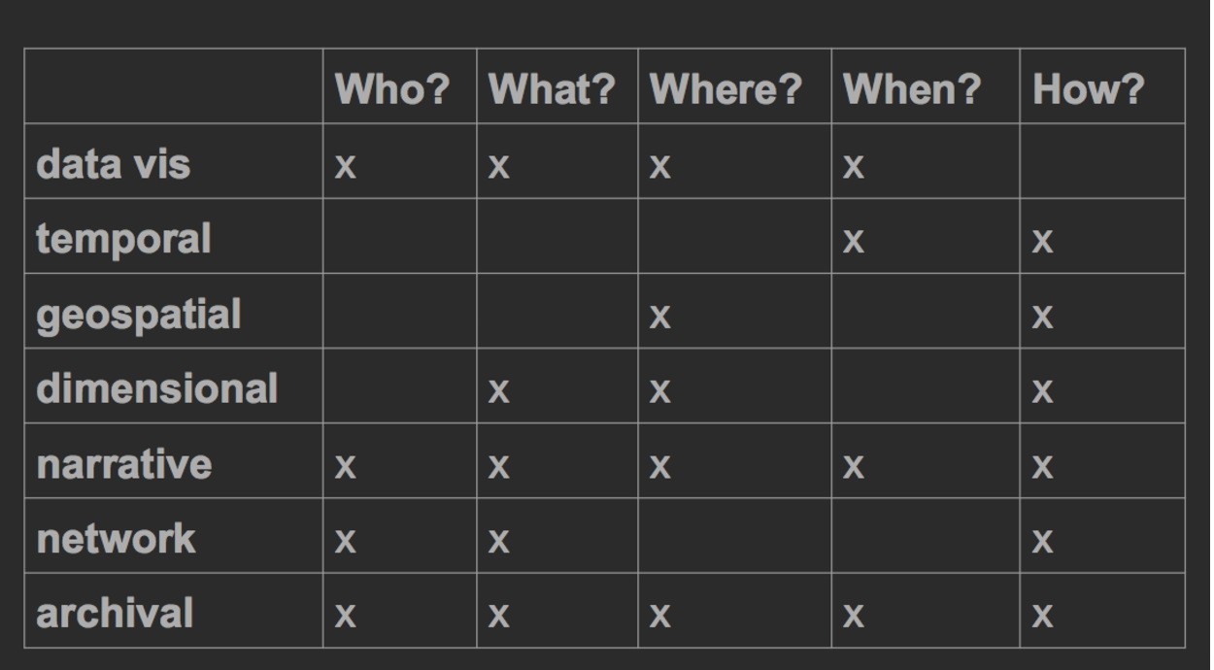
Publication Determined by Analysis

